Slide 1
Tree monitoring application
18-06-2021
Aliya Parveen, Nupur Dande, Mayuri Gujar, Vinayak Sharma, Bhupal Patil, Varad Sanpurkar

Slide 2
CONTENT
Project Overview
Problem Statement
Proposed Solution
Project Roadmap
Technology Used
Architectural Design
Reference Screenshots
Future Enhancements
Conclusion

Slide 3
PROBLEM STATEMENT
As we know that trees are the true source which benefits us in many different ways such as they are used for cooking purposes, furniture, Paper generation and animal fodders etc.
Nowadays, people are cutting down trees just to satisfy their needs which is causing deforestation which in turn is causing many problems such as Air pollution, No rainfall, No homes for flying creatures etc.
To overcome this, our government has declared an environment day to plant trees to amk environment an eco friendly. As we see, most of the people plants trees on this days, but the problem is once they plant they may forget the maintain the growth of that plant such as how healthy the plant is, is it height is growing correctly, are they generating fruits etc.
Due to lack of monitoring most of the plants do not grow and start diminishing due to lac of water and proper care

Slide 4
Proposed Solution
Our goal is to locate any trees around your neighbourhood on geolocation. Through the web portal anyone can check the status of the tree nearby also they can check the health of the tree. One can register himself/herself on web browser while planting any plant from anywhere and can enrol the location as well for particular tree.

Slide 5
Project Roadmap
Stage 1
Stage 2
Stage 3
Stage 4
Stage 5
1
2
3
4
5
Ideation and Brainstorming
Analysis and planning for required data and tech stack
Module-wise coding, documentation and implementation
Integration of all modules and testing
Launch

Slide 6
Technology Stack
Front End
HTML
JavaScript
CSS
Bootstrap 4
jQuery
Back End
SQLite
Python - Flask
API
Google Maps JavaScript API

Slide 7
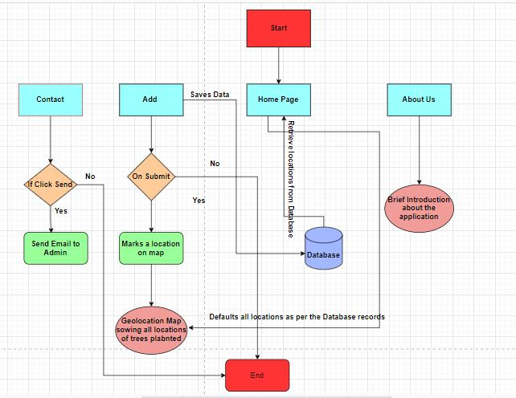
The Architecture/ Workflow

Slide 8
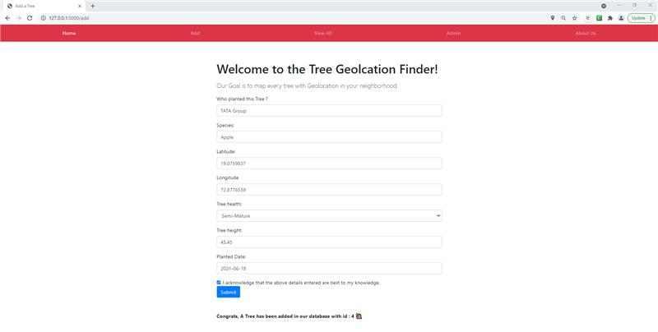
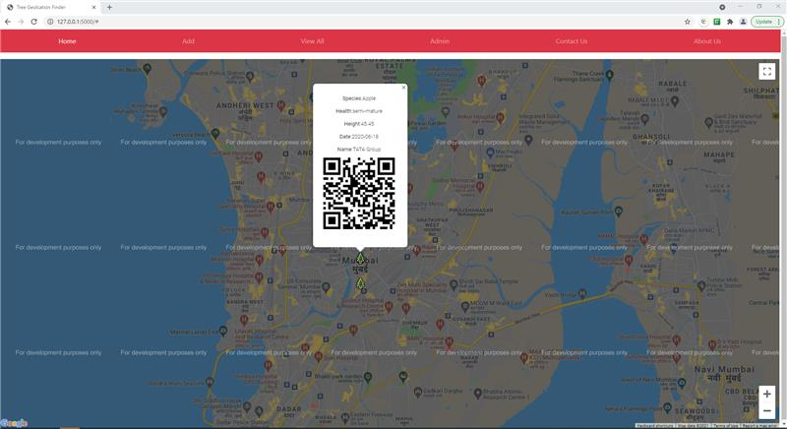
Reference Images

Slide 9
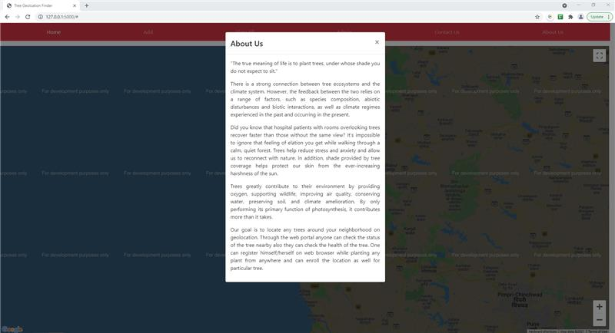
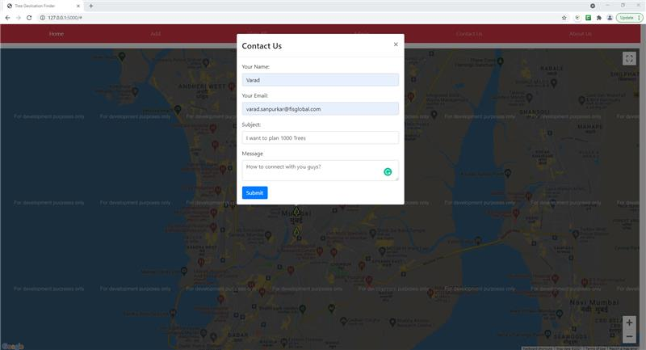
Reference Images

Slide 10
Future Enhancement
In future, we may have a tree count of any specific geolocation in the graphical format on monthly basis.
In order to get live tracking of plants, sensors can be placed at tree locations, with this we will be able to track health of the tree as expected.
There is scope to implement Image processing concepts with which we can track live health status of the plant by observing it’s colour, height and freshness of trees etc.
In future, we can integrate this database with an centralised Database which is used across by all NGO's, Based on analytics we can find the details such as which all species can be found under which location.

Slide 11
Conclusions
This application will benefits us in tracking the number of tree planted on specific geolocation, Tree health etc. Using this information we can save many trees from diminishing due to lack of water and other factors.

Slide 12
Thank You

